Slide 1
An Introduction to ArgumentScript
By Alex Jensen

Slide 2
History/Overview
Created by Alex Jensen in A.D. 2019
Currently in its first version, 1.0
Written totally in propositional logic form, don’t even try to implement a loop or a print statement, the compiler will yell at you very loudly

Slide 3
Development Process
I first had to spend 3 weeks trying to get ANTLR to install correctly on my computer
From there, I could begin creating my grammar:

Slide 4
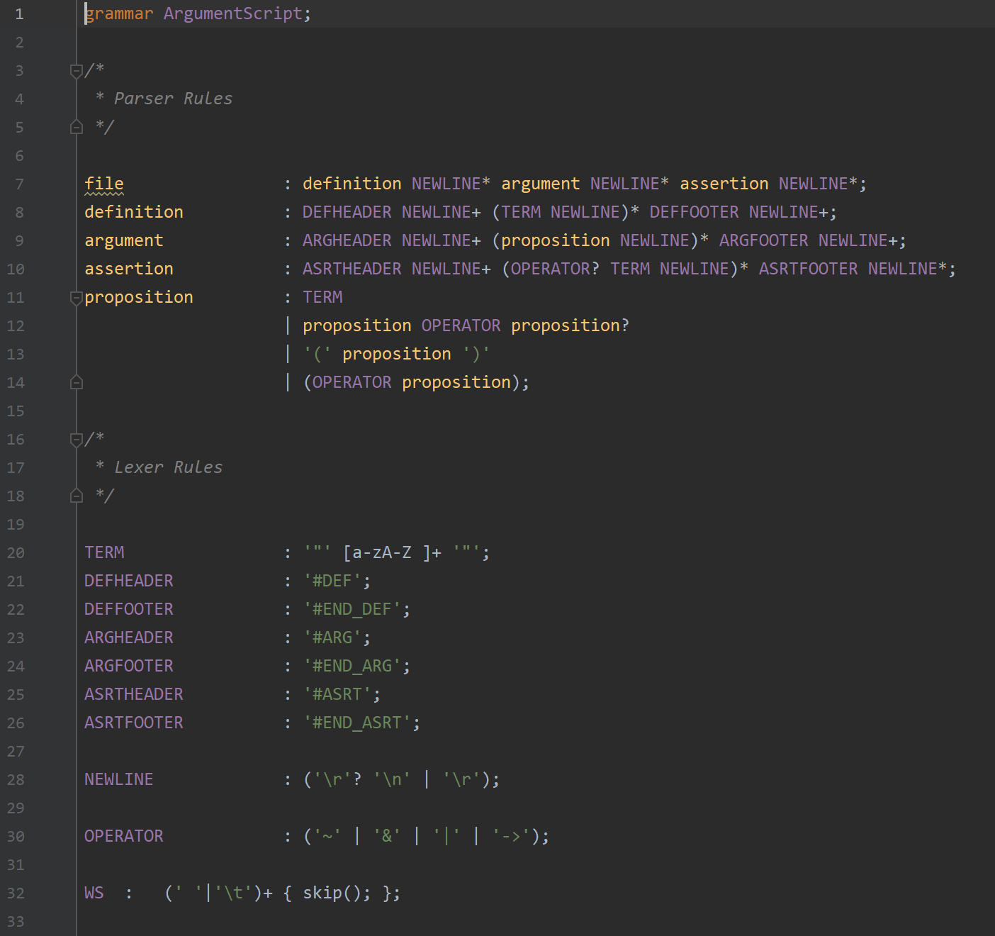

Slide 5
Development Process
I first had to spend 3 weeks trying to get ANTLR to install correctly on my computer
From there, I could begin creating my grammar
Consists of Lexer (tokenizer) and Parser rules
By using the ANTLR Java program, I was then able to generate the files necessary to parse a file into tokens:

Slide 6
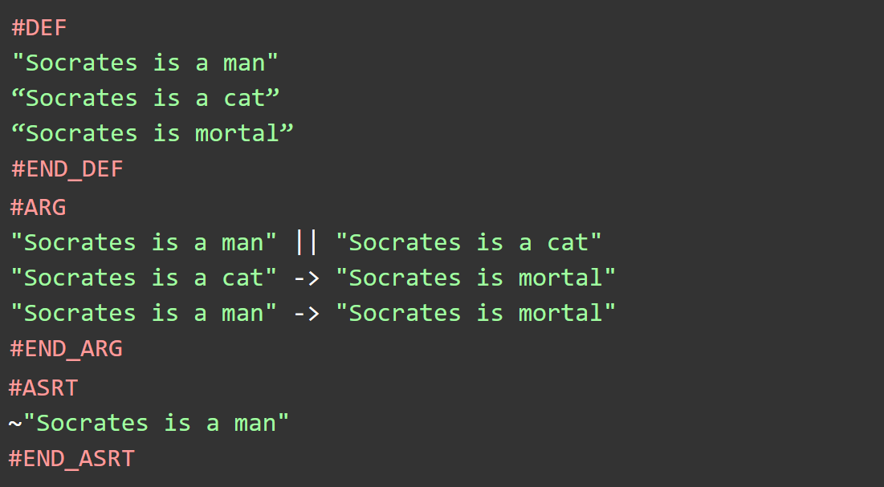
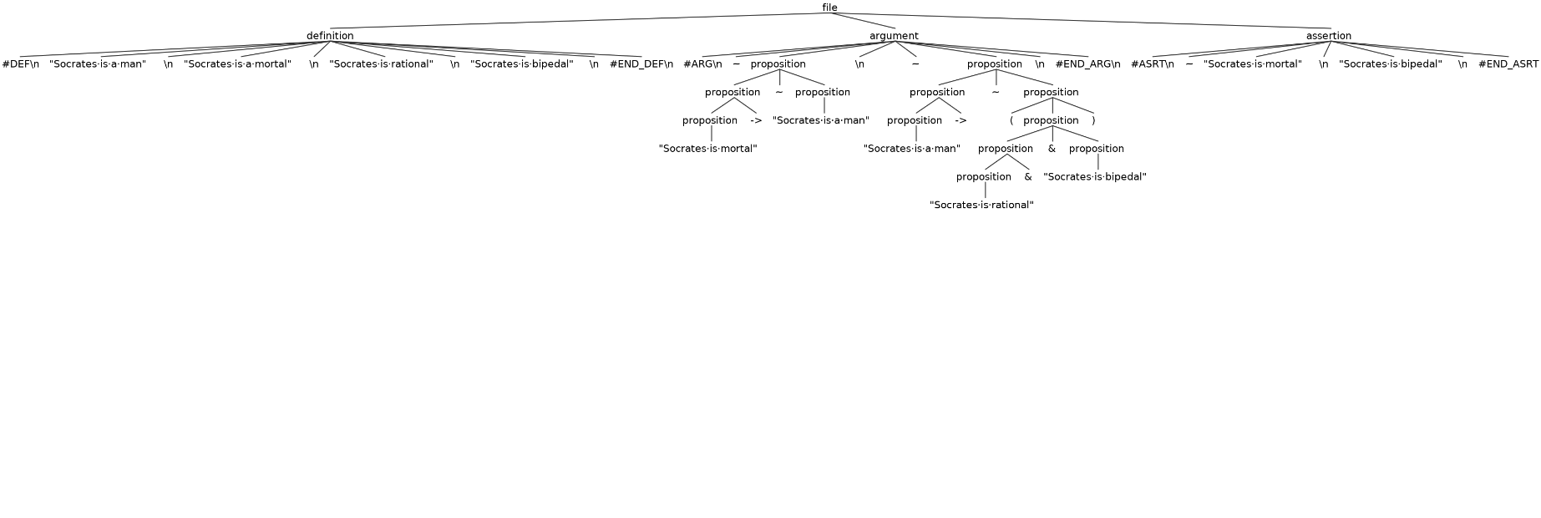
ArgumentScript File
AST Tree

Slide 7
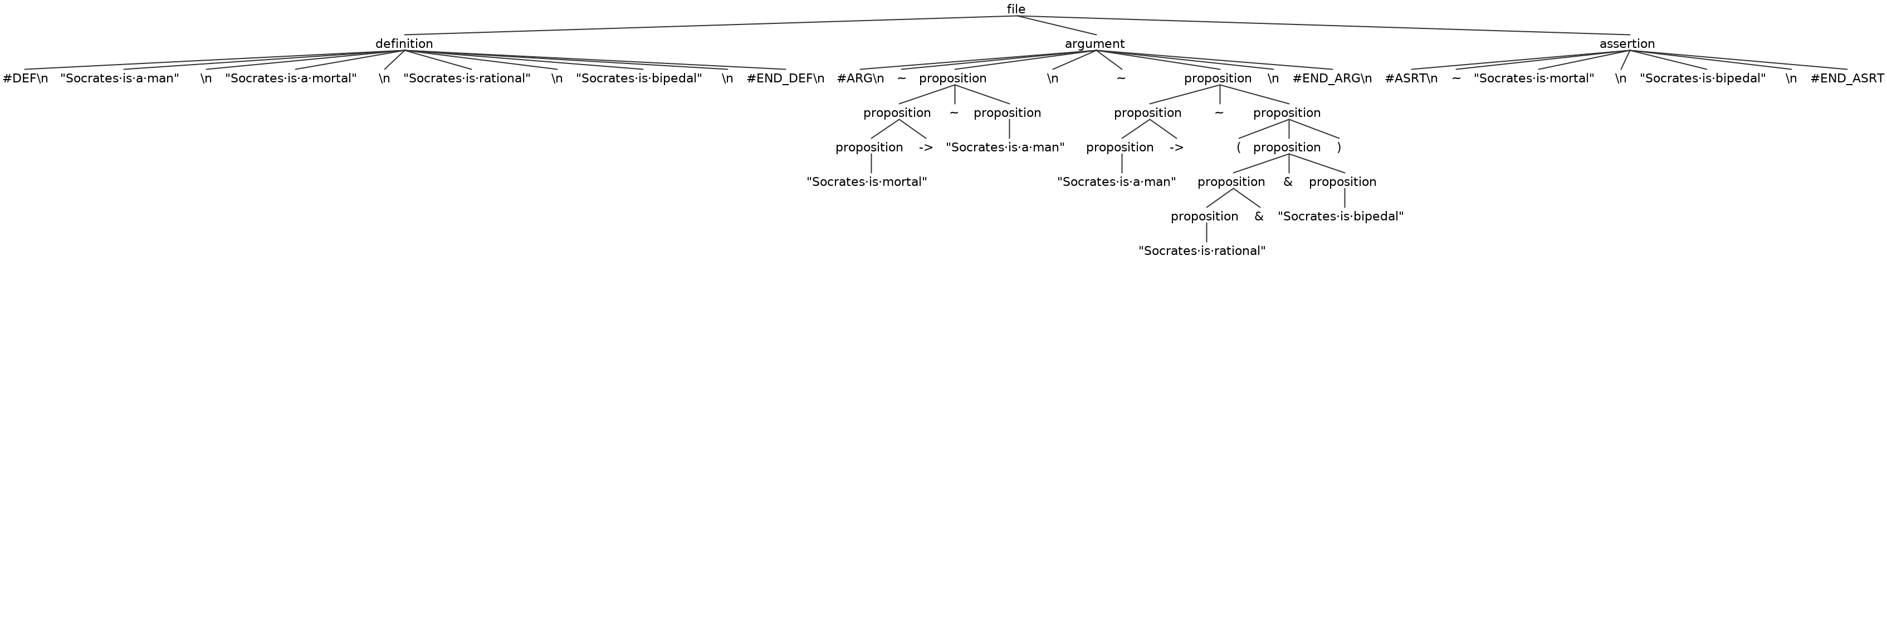

Slide 8
Development Process
I first had to spend 3 weeks trying to get ANTLR to install correctly on my computer
From there, I could begin creating my grammar
Consists of Lexer (tokenizer) and Parser rules
By using the ANTLR Java program, I was then able to generate the files necessary to parse a file into tokens
I then had to write a program which would “walk” through each node of the tree using a depth-first search, performing some operation upon each node.
This is called a Listener

Slide 9
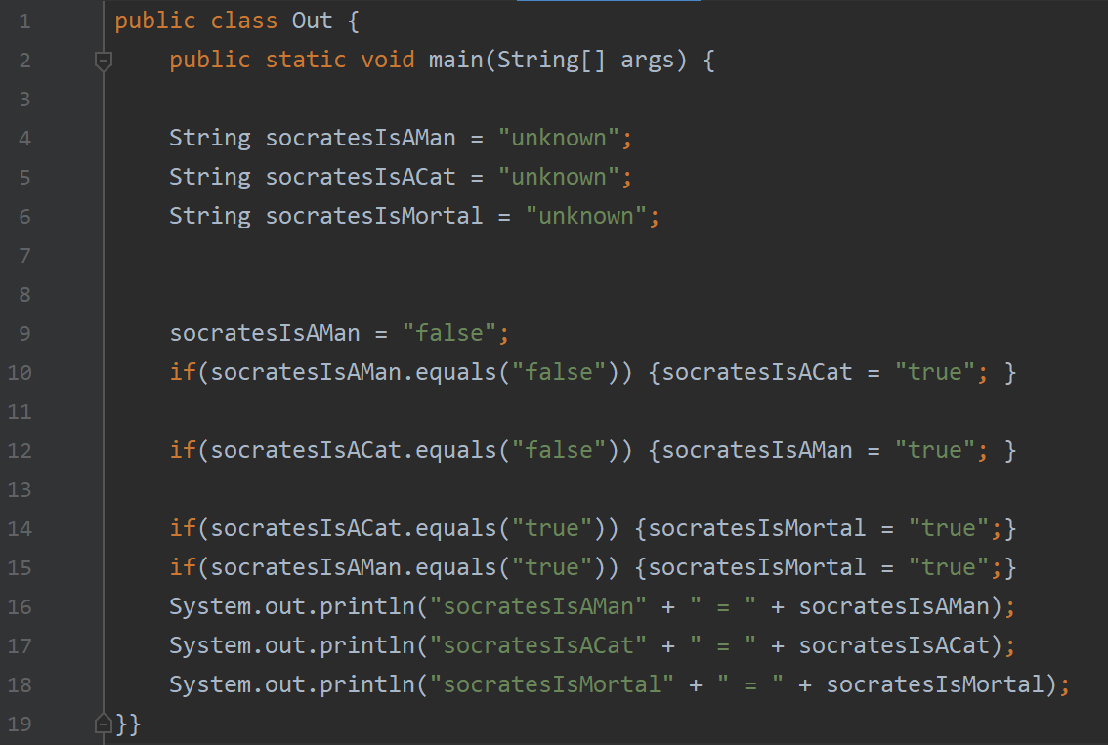
ArgumentScript File
Generated Java File

